Slide 1
Intern Management System
Mini Capstone Project

Slide 2
Project Overview
Goal:
Manage interns efficiently
Add, view, search, update, delete
Simple UI for users
Technologies:
Python
SQLite (database)
Streamlit (UI)

Slide 3
Features
Add Intern | ✅
View Interns | ✅
Search Intern by Name | ✅
Search by Department | ✅
Update Intern | ✅
Delete Intern | ✅
Index for optimization | ✅

Slide 4
Project Structures
intern_management_system/ │ ├── app.py # Streamlit UI ├── database.py # DB connection & table creation ├── intern_service.py # Operations └── README.md

Slide 5
Database
Column | Type | Notes
id | INTEGER | Primary Key, Auto Increment
name | TEXT
email | TEXT
phone | TEXT
department | TEXT | Indexed for faster search

Slide 6
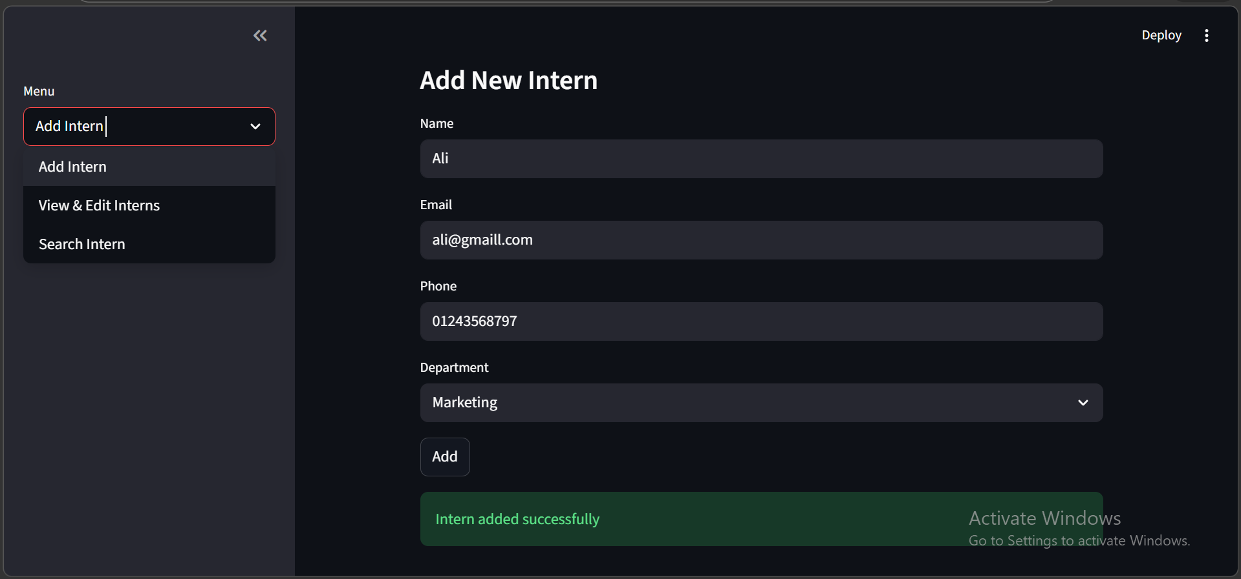
Add Intern

Slide 7
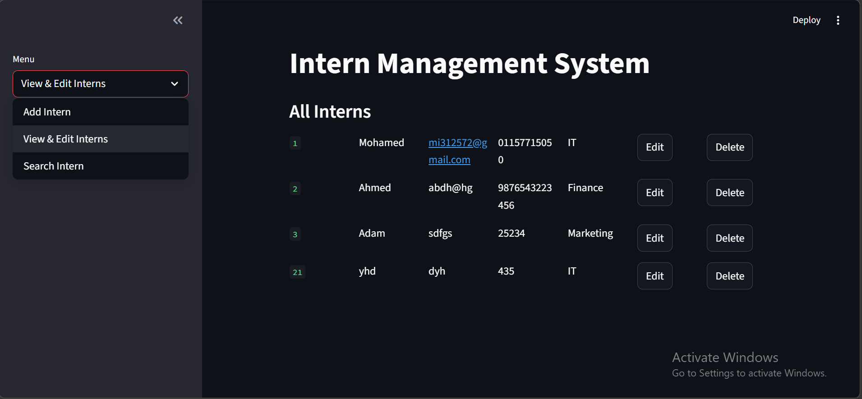
View Intern

Slide 8
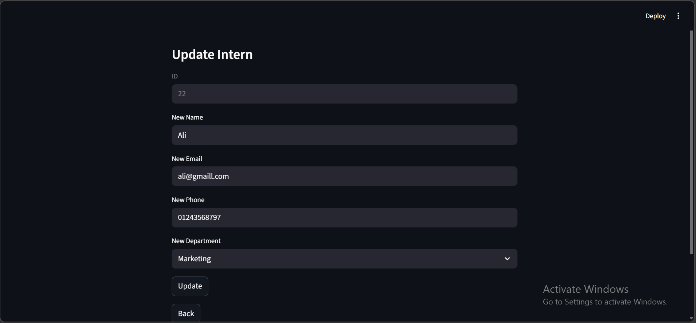
Update Intern

Slide 9
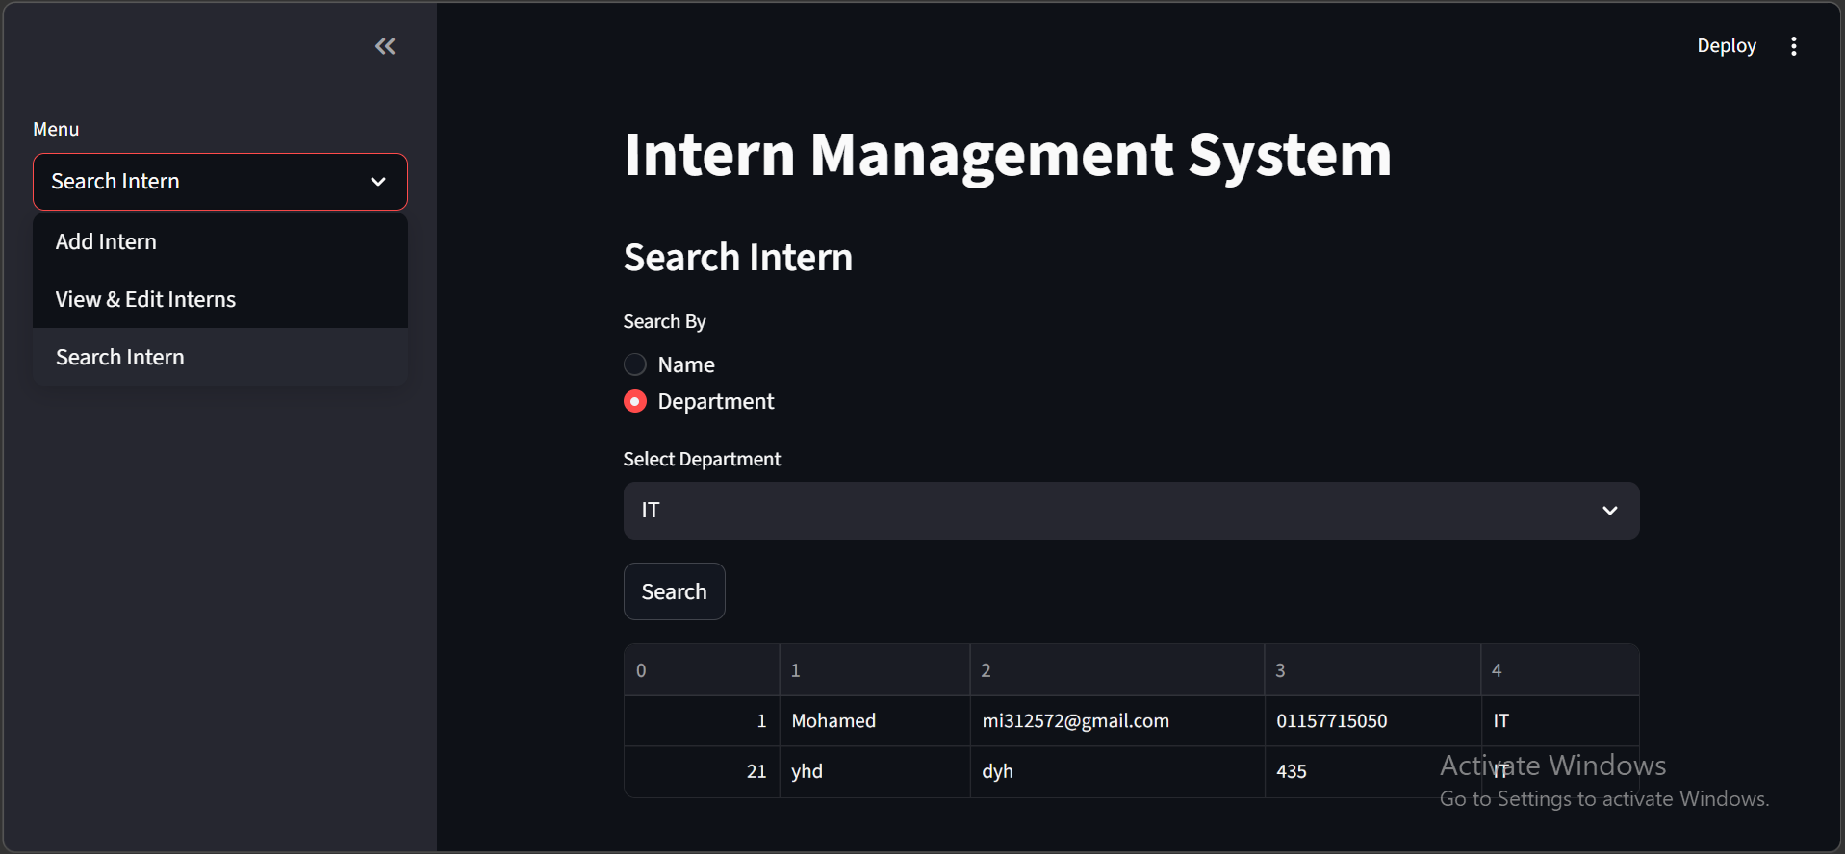
Search Intern

Slide 10
Thank you

